Slide 1
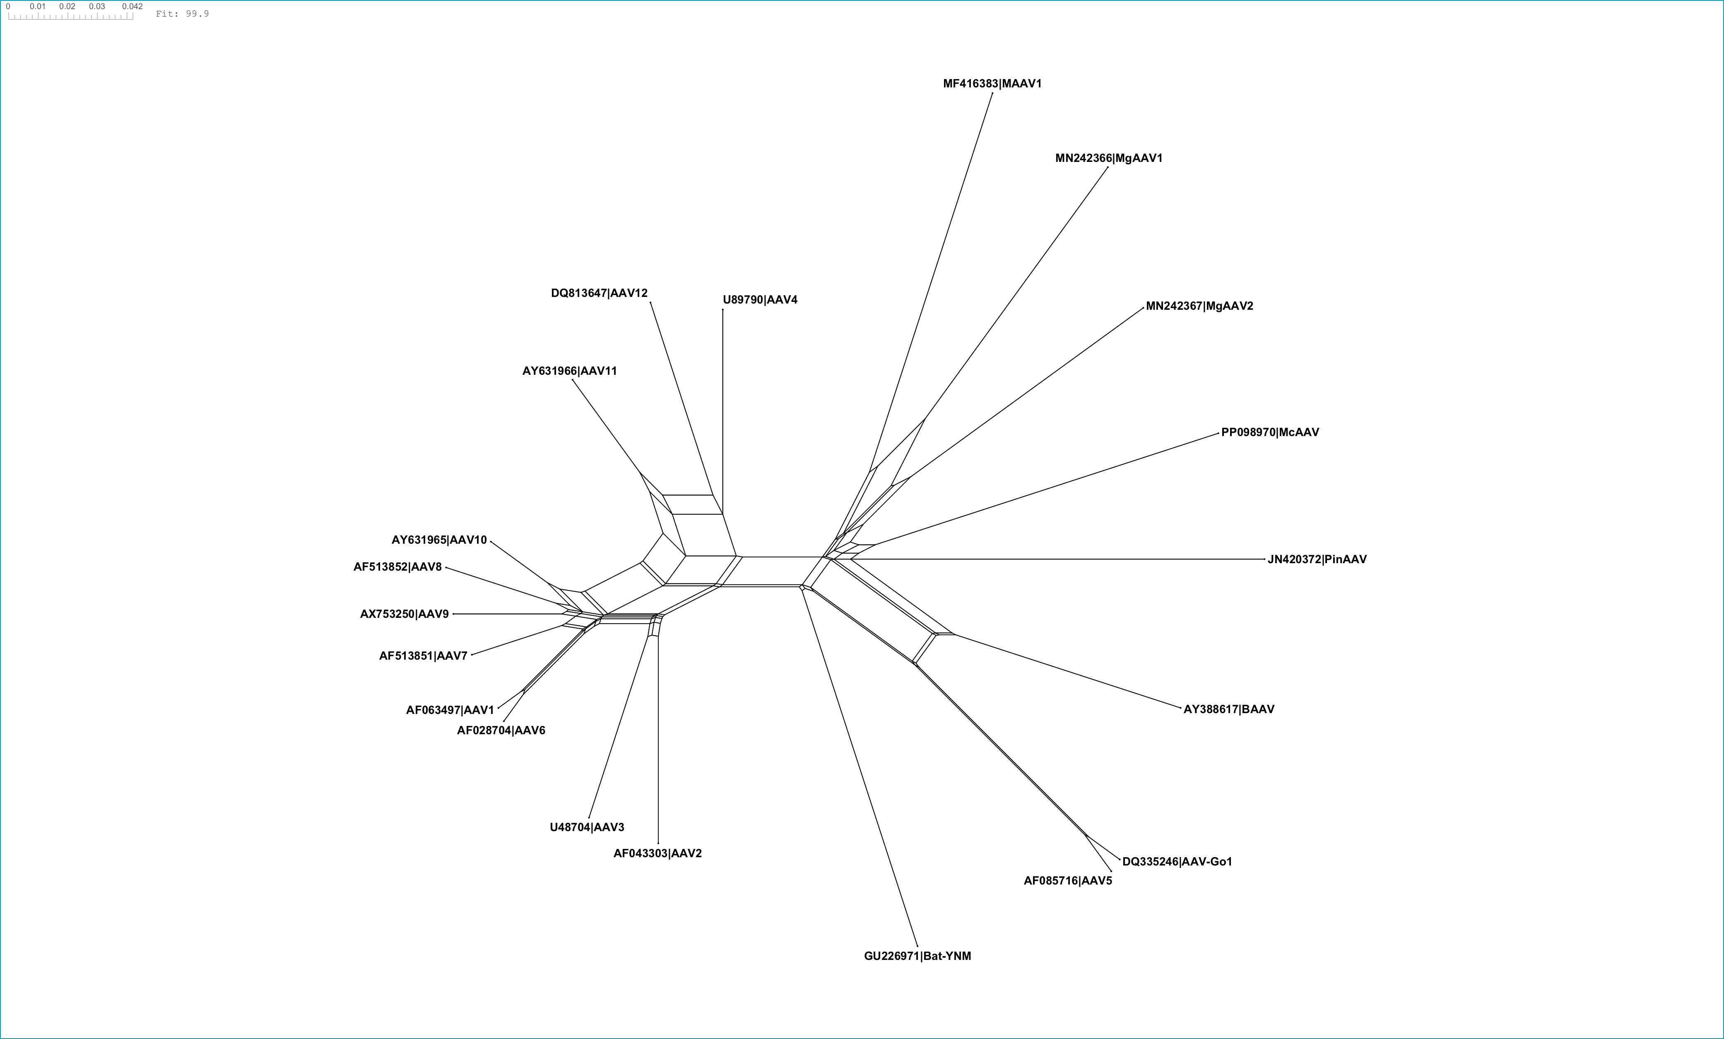
Split decomposition network based on conserved Rep78 and VP1 regions. A SplitsTree network was generated from a concatenated alignment of 12 conserved partitions: 5 from the Rep78 protein and 7 from the VP1 capsid protein. The alignment includes AAV sequences and selected outgroups. Reticulation patterns indicate conflicting phylogenetic signals consistent with recombination. Taxa highlighted with red boxes are those inferred to have acquired M-wide capsids through horizontal transfer events.

